Slide 1
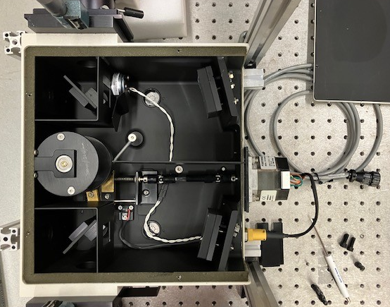
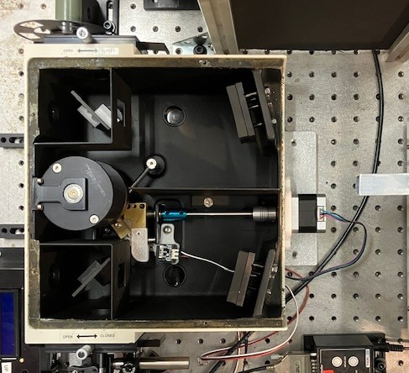
Arduino “BLI” monochromator controller – peripheral hardware setup for OBB
Repurposed Optical Building Blocks (OBB) monochromators (table is 1” grid)
A professionally-built setup with NEMA-23 stepper motor. Includes shutter solenoid (H-1079-032 1208, probably 12V) and optical limit switch.
Motor part number: Kollmorgen P21NRXS-LNN-NS-17
Our home-modified setup with NEMA-17 1.5Amp stepper motor (Twotrees).
Employs mechanical limit switch (WELWIK 3-pin end stop switch for 3D printers).
reducing flexible shaft coupler
6.35 mm (1/4 inch) to 5 mm
3D printed adapter for motor mount
3D printed adapters for paddle and switch mount
Copyright 2026 Andrew B. Greytak, University of South Carolina – Documentation shared via CC-BY-SA-4.0
https://github.com/Greytak-Chemistry-Lab/arduino-bli-mono-controller/LICENSE

Slide 2
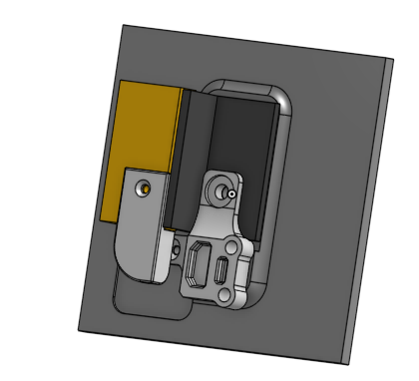
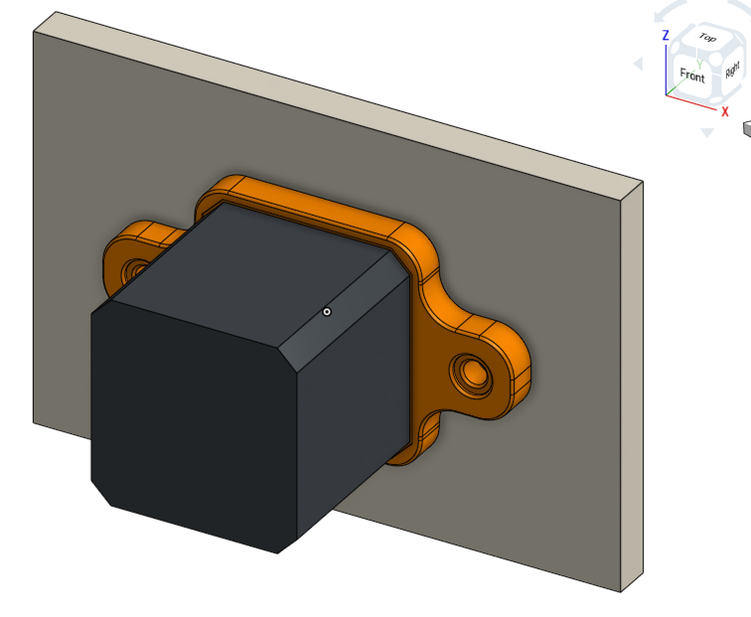
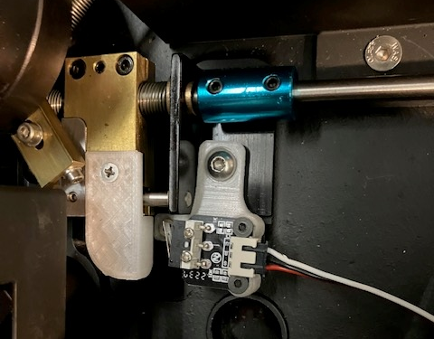
Parts list
Part | Part Number / Supplier | Note
Stepper motor NEMA-17 1.5 amp | 17HS4401 / Twotrees (Amazon) | No longer available from this vendor, but part# is standard
Limit switch (3-pin end stop switch) | WELWIK (Amazon)
Limit switch cable (1M XH2.54 3PIN Cable Endstop Switch Wire) | GRGRG (Amazon) | XH2.54 male/male
Stepper motor cable 4pin to 6pin, 1.5 M | TIEXYE (Amazon) (Compatible with NEMA 17 for Ender 3 printer) | XH2.54 mm 4pin male / PH 2.0 6pin male
6.35mm (1/4”) shaft coupler | Twidec 6.35 mm rigid coupler | Blue aluminum part in photo
Flexible reducing coupler | Xnrtop 5mm to 6.35 mm aluminum
Limit switch paddle | Gryphon Drake designs “IR spectrometer limit switch” assembly (Accessible on Greytak Chemistry Lab Onshape space) | Attaches to moving part
Limit switch mount | Gryphon Drake designs “IR spectrometer limit switch” assembly | Bolts to instrument floor
Motor mount | GDD “spectrometer motor bracket”
Grating 50x50x6 mm | Newport 33010FL01-520R | For NIR: 600 lines/mm blazed 1.02 um, blaze angle 17.46 degrees
3D designs copyright 2024 Gryphon A. Drake
Documentation Copyright 2026 Andrew B. Greytak, University of South Carolina – Documentation shared via CC-BY-SA-4.0
https://github.com/Greytak-Chemistry-Lab/arduino-bli-mono-controller/LICENSE

